Slide 1
Accelerating Immunotherapy Drug Development with Simple Cell-Based Assays for Immune Checkpoint Receptors
Presented by Andrew Green
Senior Business Development Manager
October 2021
Notes:
Created by Jennifer Lin-Jones, Ph.D. Senior Group Leader, Assay Development, R&D Department, Eurofins DiscoverX

Slide 2

Eurofins DiscoverX
Strong Foundation | Technical Expertise | End-to-End Solutions
Supporting programs from Research, Discovery to Lot Release
Products Division headquartered in Fremont, CA
Additional sites in Missouri, USA and Poitiers, France
800+ off-the-shelf assays for in-house development
Over 10,000 customers in NA, APAC and EMEA
Dedicated Operations
Over 45 years of cumulative technical experience in
Cell line engineering & characterization
Bioassay development, optimization & qualification
Analytical Cell Banks
Membrane Preps and Frozen Assay Ready Cells
Bulk Enzyme Production
Deep Domain Expertise
Successfully implemented at global Pharma, Biotech & CRO
Products implemented in discovery & development
Over 50 billion data points screened
2,000+ publications
Several active Biotech/CRO-partnered programs
Implemented in lot release of several marketed biologics
Established Brand

Slide 3
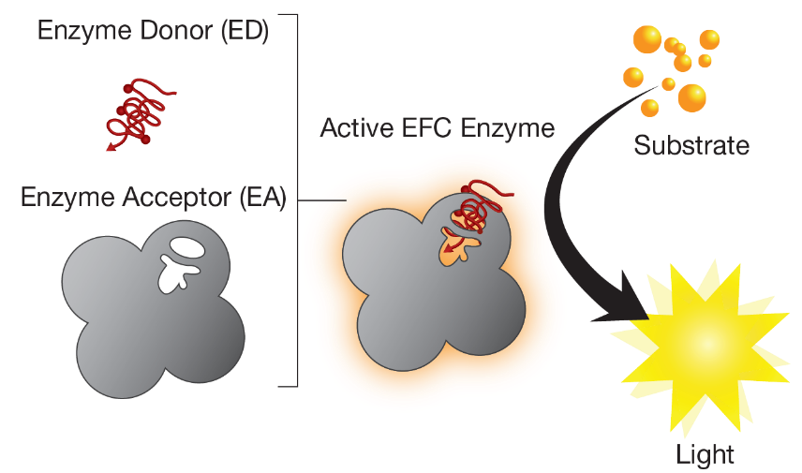
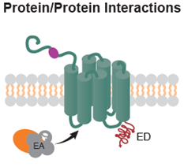
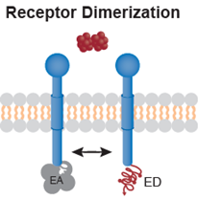
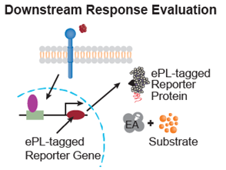
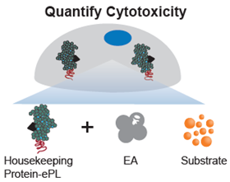
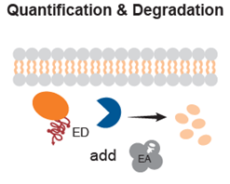
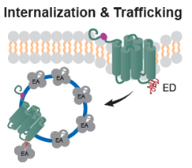
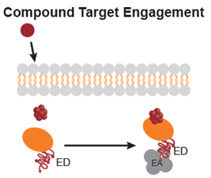
Enzyme Fragment Complementation (EFC)
Robust Platform for Cell-Based Assays
Split β-galactosidase reporter system can be engineered to generate target-specific, homogeneous cell-based assays for immuno-oncology therapeutics

Slide 4
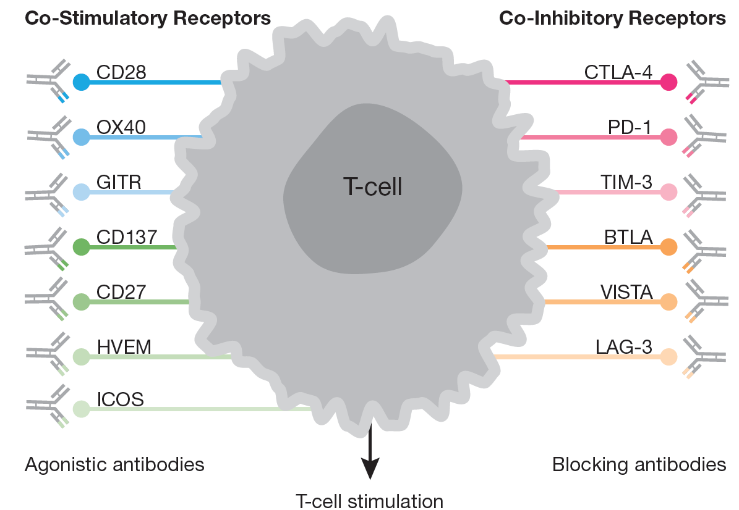
Targeting T-Cell Co-Stimulatory and Inhibitory Checkpoint Receptors
Tools are needed to screen for and develop new therapeutics
Push the gas pedal on T cell activation to stimulate the immune system
Remove the brakes inhibiting T cell activation to stimulate the immune system
Modulate immune response to destroy cancer cells

Slide 5
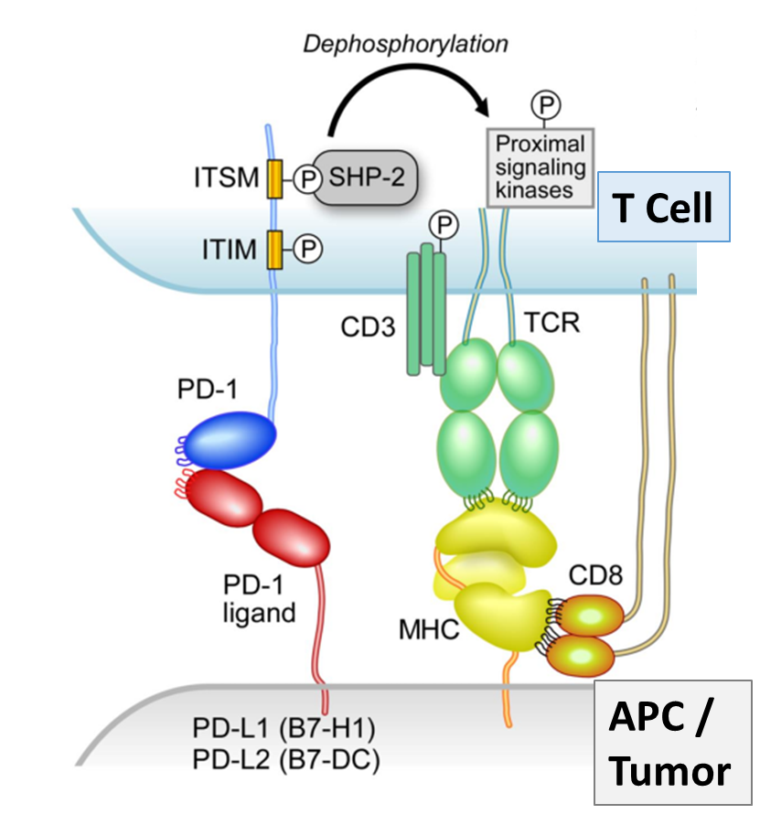
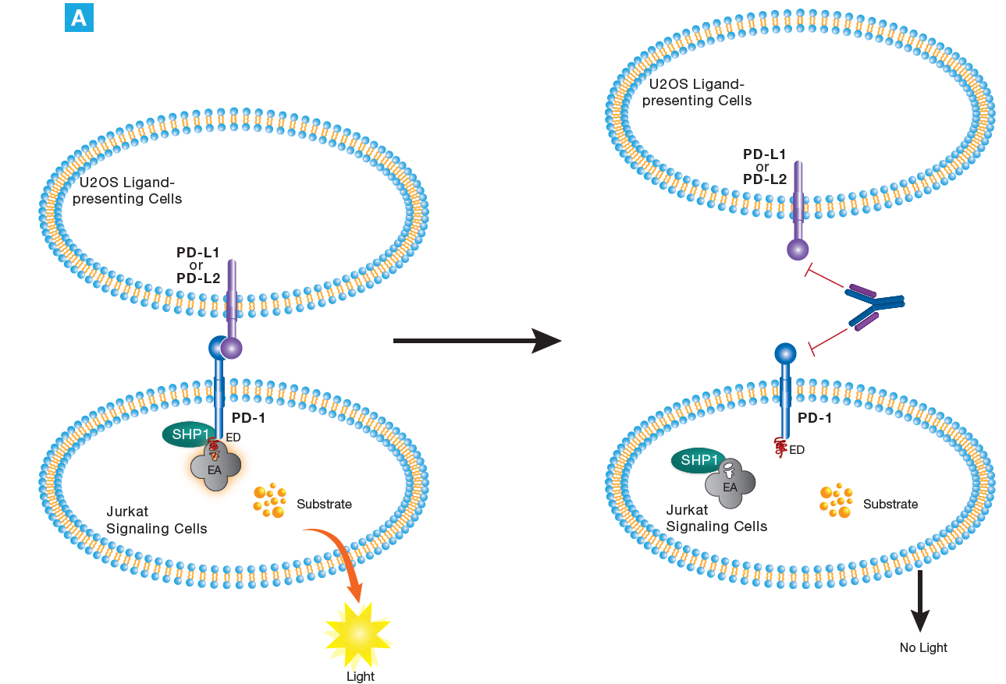
PD-1 Signaling Assay Concept
Quantify early step in PD-1 mediated inhibition of T cell activation: SHP recruitment
Mechanism of Action
Assay Design
Assay measures this early event:
SHP recruitment
Anti-PD-1
or Anti-PD-L1 or Anti-PD-L2
Antibody or Molecule

Slide 6
PD-1 Signaling Assay is Highly Specific and Stability-Indicating
Assay-Ready (RTU) Protocol
Thaw PD-1 Cells and seed in assay plate
Prepare antibody dilutions and add to assay plate
Thaw U2OS PD-L1 cells and add to assay plate
Add Detection Reagent to assay plate
Read signal on plate reader
16h
1h
1h
3h
Suitable for Small Molecules or Biologics
Specificity (Agonist)
Specificity (Antagonist)
Small molecule negative control
Anti-PD-1 antibody
Small molecule PD-1 / PD-L1 inhibitor

Slide 7
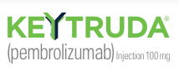

PD-1 Signaling Assay Suitable for Therapeutic Development of Both PD-1 Agonists and Antagonists
Immuno-oncology
Auto-immunity
PD-1 Antagonist
PD-1 Agonist
PD-1 Signaling assay is a versatile screening tool for PD-1 antagonists (I/O) or for PD-1 agonists (novel therapies for autoimmunity). The latter data were generated in co-culture with Fcƴ receptor expressing cells.

Slide 8
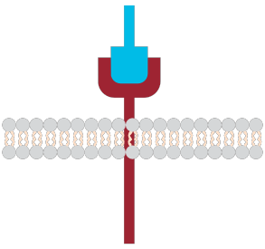
Complementary Cell-Based Assays for Comprehensive Understanding of a Drug Molecule’s MOA
Cell-based Signaling Pathway Assays
Upstream (Receptor-Proximal) Readout (Non-Reporter Gene Assays) | Downstream (Distal) Readout (Reporter Gene Pathway Assays)
Represent a readout more proximal to receptor activation and upstream of signal transduction and transcriptional changes. | Represent a distal pathway readout reflective of a phenotypic endpoint (e.g. proliferation)
Measure status of a specific functional event upstream of transcription | Measure changes in transcription that affect reporter protein expression
Results may more directly reflect drug MOA: measures a specific functional event | Results can integrate effects from multiple inputs on a signaling pathway: sum of downstream signaling events
Produce modest to large assay windows, with short assay times and low variability
Ligand/Activator
Target Receptor
Upstream Events
Cell Membrane
Signaling Pathway
Nucleus
Transcription Factor
Distal Events
Transcriptional Regulatory Element
Reporter Gene
Notes:
Comparison of the two PD1 assays to contrast results from reporter gene assays and non-reporter gene assays that measure outputs from events upstream of transcription.
Non-reporter gene assays – measure specific events in the pathway or any events upstream. May reflect more directly the MOA of a particular drug and pinpoint the step where the drug has effects. Specifically for the PD1 pathway, the signaling assay is quite proximal or early in the pathway – quantifies signaling adaptor recruitment to the receptor
Extremely short assay time (sometimes shorter than reporter assays which are 6 hours to overnight to allow transcription and translation). Low variability. Cell Lines have been used to develop ready to use BioAssay formats for QA applications
Reporter assays – represent the cumulative effect of signaling through a pathway since it is downstream. Could monitor multiple inputs modulating a response (eg. TCR activation AND PD1 inhibition. More reflective of effects on the cellular response rather than a specific step in a pathway. While assay times are longer than for the signaling assays, assay times are still shortened compared to phenotypic readouts. Reporter gene readouts generally render large windows but may be limited in more complicated systems like PD1 where multiple inputs are incorporated into the assay.

Slide 9
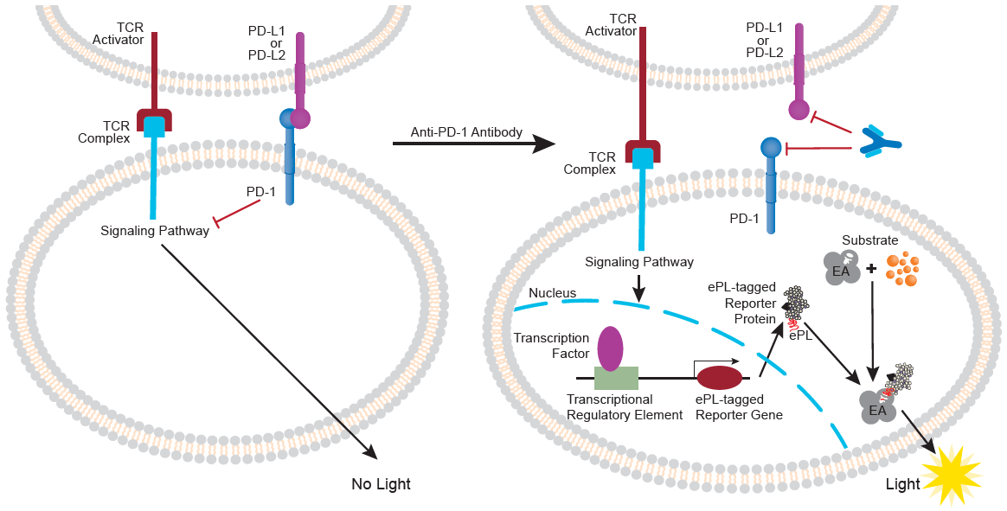
Monitor PD-1 Inhibitor Activity Downstream of TCR Activation:
Assay Principle
U2OS PD-L1/TCR Activator cells + Jurkat PD-1-NFAT
U2OS PD-L1/TCR Activator cells + Jurkat PD-1-NFAT + anti-PD-1 Ab
TCR activation inhibited by PD-1 activation
Reduction in reporter protein expression
Antibody inhibits PD-1 activation
PD-1 inhibition of T cell activation released
Increase in reporter protein expression
TCR = T cell receptor
Notes:
This schematic illustrate how the assay works:
It is a two cell co-culture system where a ligand cell line – U2OS co-expressing the T-cell activator and the PD1 ligand (PD-L1) to inhibit are cultured together with the Jurkat NFAT reporter cells expressing PD1 to make them responsive to PD-L1. When the two cell lines are cultured together, some T-cell activation is measured but as shown on the previous slide, it is reduced compared to co-culture of cells without PD1 and PDL1 co-expressed. Thus when an inhibitor of PD1 or PDL1 is added to the co-culture, PD1 activation and T-cell inhibition is blocked, and greater levels of T-cell activation are observed as there is a release of inhibition.

Slide 10
PathHunter® Jurkat PD-1-NFAT Pathway Reporter Assay:
Evaluate PD-1 Checkpoint Receptor Mediated Inhibition of T Cell Activation
PD-1 inhibitory receptor introduced into PH Jurkat NFAT cells attenuates T cell activation
PD-1 checkpoint receptor inhibition of T cell activation can be monitored by PD-1 receptor co-expression in Jurkat NFAT reporter cells in co-cultures with U2OS TCR activator cells co-expressing PD-L1 ligand
Jurkat NFAT / U2OS TCR Activator Co-Cultures
Decreased T cell activation when PD-1 is
co-expressed in Jurkat NFAT cells and PD-L1 co-expressed with TCR activator in U2OS
Notes:
Here we demonstrate how the Jurkat NFAT-reporter assay cells were further developed to generate an assay for the PD-1 checkpoint receptor.
These pathway reporter assay cells were used in combination with cells overexpressing a TCR activator by co-culturing the Signaling Pathway reporter cells with the TCR activator cells instead of antibody as ligand.
The result is a large signal increase due to TCR and T-cell activation. When PD-1 is expressed in the reporter gene cells, even in the absence of adding the PD-1 ligand, PD-L1 to the TCR activator cells, there is a reduction in the amount of T-cell activation. When the PD-L1 ligand is added to the TCR-activator cells and co-cultures with the PD1-NFAT cells, the reduction in the T-cell activation is further reduced.
Thus, we have developed an assay to screen for therapeutic molecules that can release PD1 inhibition on T-cell activation.

Slide 11
Measure Proximal & Distal Events in the PD-1 Signaling Pathway
Both PathHunter® PD-1 assays types provide a comprehensive understanding of the PD-1 pathway and the MOA of the anti-PD-1 Antibody
Assays are robust and measure PD-1 inhibition with sensitive responses from an event either proximal (PD-1 SH2 recruitment, Jurkat PD-1 Signaling) to receptor activation, or distal (NFAT-regulated reporter, Jurkat PD-1-NFAT)
PathHunter Jurkat PD-1 Signaling Assay
(93-1106C19)
PathHunter Jurkat PD-1 NFAT Reporter Assay
(93-1141C19)
Notes:
The data from the two assays is shown on this slide. Both assays exhibit similar potencies in the 100 nM range. Larger window with the signaling assay as it works independently of TCR activation?
Comparison of antagonist testing results from the two different PathHunter PD-1 Assays. A. The PathHunter PD-1 Pathway Reporter Assay was tested in a dose-response format with an Anti-PD-1 Antibody. The Reporter assay cells co-cultured with the PathHunter U2OS PD-L1/TCR activator cell line results in increased reporter expression due to blocking PD-1 inhibition of TCR activation, resulting in increased NFAT-regulated gene expression. The reporter assay reads out downstream effects of PD-1 receptor activation pathway by measuring NFAT activation of transcriptional regulatory elements driving reporter protein expression. Conversely, B. represents results from PathHunter Jurkat PD-1 SHP2 Signaling Assay antagonist testing. An Anti-PD-1 Antibody was used to block PD-1 activation mediated by co-culture with the PathHunter U2OS Ligand Cell Line and measures effects of proximal PD-1 signaling independent of TCR activation. Both assays are robust and measure inhibition with sensitive responses, from either a distal (Figure 7A) or proximal (Figure 7B) event as shown in Figure 4.

Slide 12
Targeting T-Cell Co-Stimulatory and Inhibitory Checkpoint Receptors
Tools are needed to screen for and develop new therapeutics
Push the gas pedal on T cell activation to stimulate the immune system
Remove the brakes inhibiting T cell activation to stimulate the immune system
Modulate immune response to destroy cancer cells

Slide 13
CD28 and ICOS Co-Stimulatory Receptors Also Signal Through SH2- Domain Containing Proteins
Assays measure ligand-mediated recruitment of Grb2 (CD28) or p85 (ICOS)
Robust Assays for CD28 and ICOS Co-Stimulatory Receptors Enable Rank Ordering of Agonist Antibodies

Slide 14
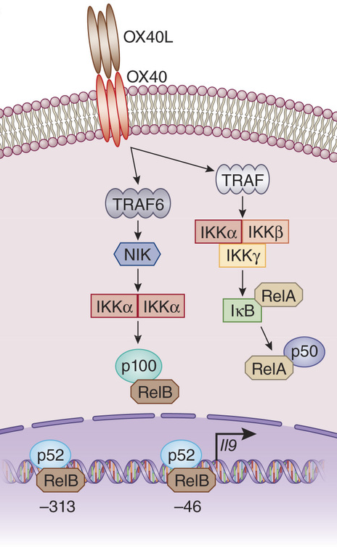
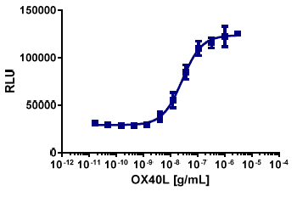
PathHunter® OX40 Assay – Quantifies NIK Stabilization in Response to Pathway Activation
Mechanism of Action
OX40 Signaling Assay (93-1080C3)
►
EC₅₀ | 27.4 ng/mL
S:B | 4
Assay Time | 5 h

Slide 15
PathHunter® Pathway Reporter Assays – Measure Pathway activation using Endogenous or Heterologously-Expressed Receptors
Assays for Co-stimulatory TNFR superfamily receptors
PathHunter U2OS NF-κB
Pathway Reporter Assay
PathHunter HEK293 CD27-NF-κB Pathway Reporter Assay
2000000
400000
S:B = 26.3
S:B = 6.6
1500000
EC
50
= 225.4 ng/mL
300000
EC
50
= 12.7 ng/mL
U
U
L
1000000
L
200000
R
R
►
500000
100000
0
0
10
-11
10
-10
10
10
10
10
10
10
-11
10
-10
10
-9
-8
-7
-6
-5
-9
10
-8
10
-7
10
-6
10
-5
10
-4
[CD40L], g/mL
[CD27L], g/mL

Slide 16
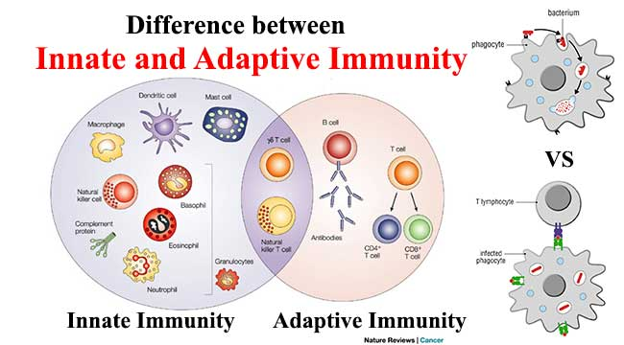
Immunotherapy Agents:
Targeting Innate vs Adaptive Immunity
Therapeutic Modalities
TLR Agonists
STING Agonists
SIRPα / CD47
Checkpoint Inhibitors
(anti-PD-1/PD-L1)
Checkpoint agonists
(OX40, CD137, ICOS)
BiTEs, TRIKEs, etc

Slide 17
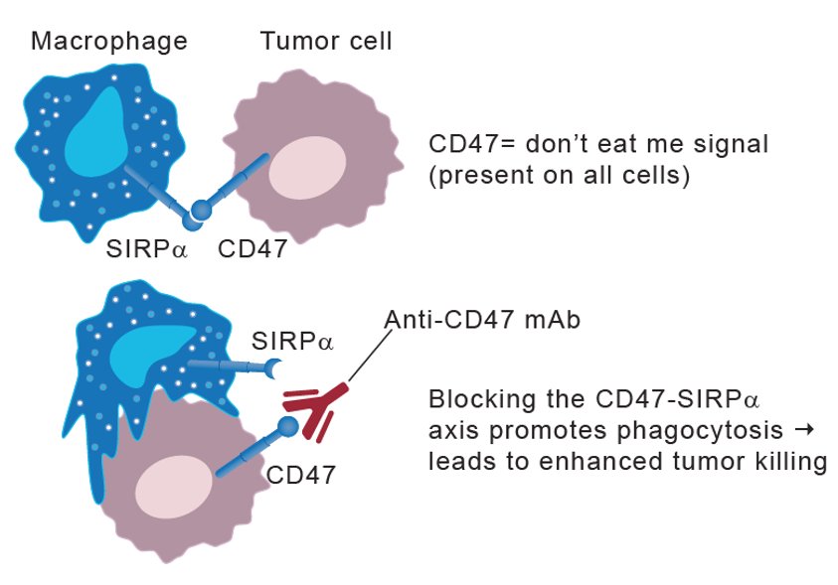
The SIRPα / CD47 Axis
An Innate Immune Checkpoint
In vivo MOA
SIRPα is an inhibitory receptor expressed on macrophages and dendritic cells that promotes phagocytosis of foreign objects
CD47, the ligand for SIRPα, is expressed on nearly all cells, but is significantly up-regulated in many tumor types, especially hematological malignancies such as AML and MDS
  ‘Don’t eat me’ signal that represses signaling via SIRPα, preventing myosin-IIA accumulation at the phagocytic synapse, leading to inhibition of phagocytosis
Phagocytosis
Anti-CD47 Ab
or
SIRPα-Fc
Blocking the CD47 / SIRPα axis (e.g. with anti-CD47 antibodies, engineered receptor decoys, anti-SIRPα antibodies and bispecific agents) promotes tumor killing
  phagocytosis of the tumor
  Anti-CD47 blockade has also been shown to enhance adaptive immunity (e.g. prime an anti-tumor cytotoxic T cell response)
Tumor Killing
Notes:
.

Slide 18
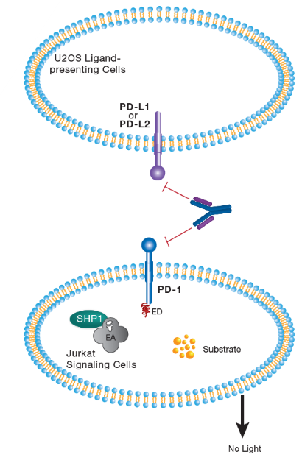
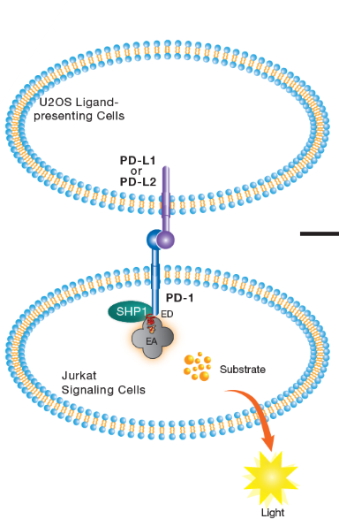
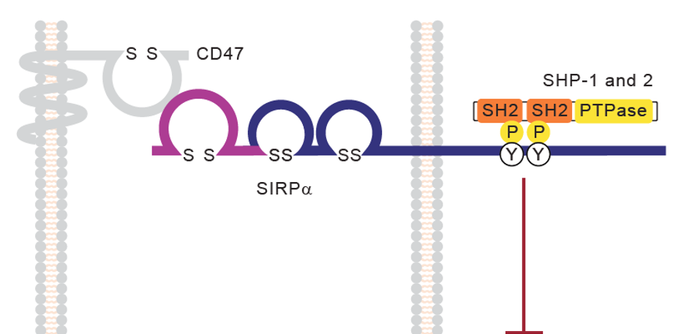
PathHunter® SIRPα Signaling Assay: Assay Concept
Co-culture SHP recruitment model based on β-galactosidase enzyme fragment complementation
Molecular MOA
Co-Culture SHP Recruitment Model
Tumor Cell
Macrophage
Jurkat Ligand Presenting Cell
Jurkat Ligand Presenting Cell
CD47
CD47
Anti-CD47
or SIRPα-FC
SIRPα
SIRPα
Phagocytosis
Assay quantifies ligand-induced recruitment of SHP-1 to ITIM motifs in C-terminal tail of SIRPα in response to phosphorylation
Adapted from Trends in Cell Biology, 2008. Vol 19, No. 2

Slide 19
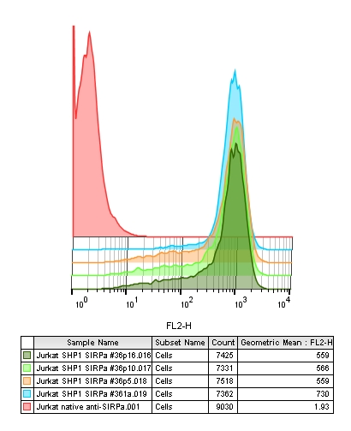
PathHunter® SIRPα (CD47) Signaling Assay
Co-culture model with stable surface expression of SIRPα and a stable functional response over 45+ passages
Cell-Presented Ligand
Stable SIRPα Surface Expression
SIRPα
SIRPα expression varies by <20% RSD over 45 passages
Agonist
Stable Functional Response
S/B : 17% RSD over 45 passages
IC₅₀ : <19% RSD over 45 passages
Antagonist

Slide 20
PathHunter SIRPα Signaling Assay:
Excellent Specificity and Stability-Indicating Properties
Assay Specificity
Assay Specificity
Stability-Indicating

Slide 21
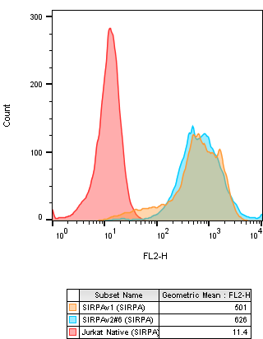
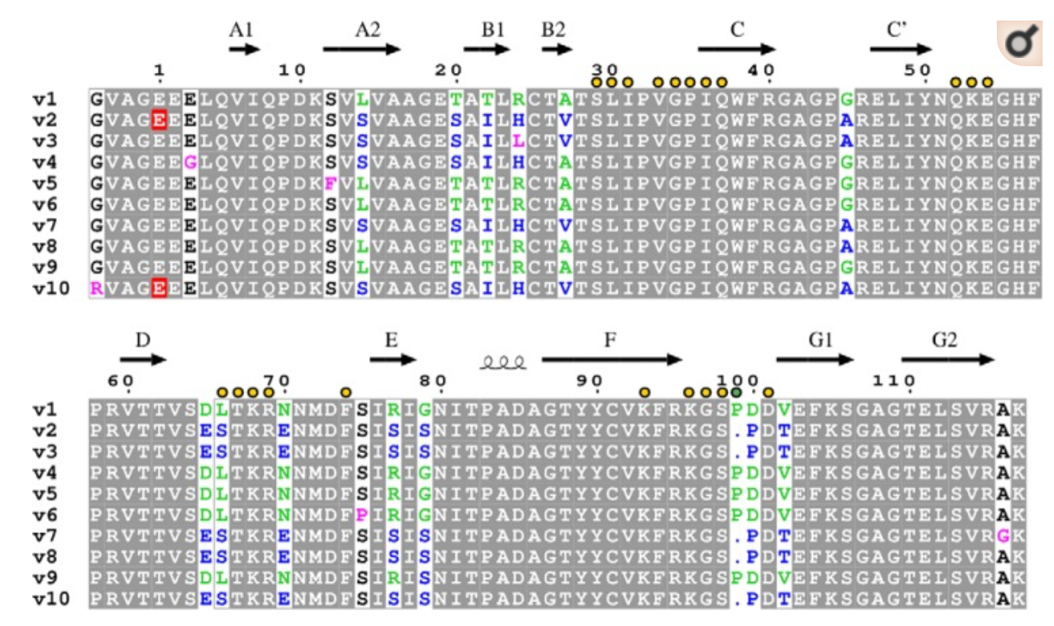
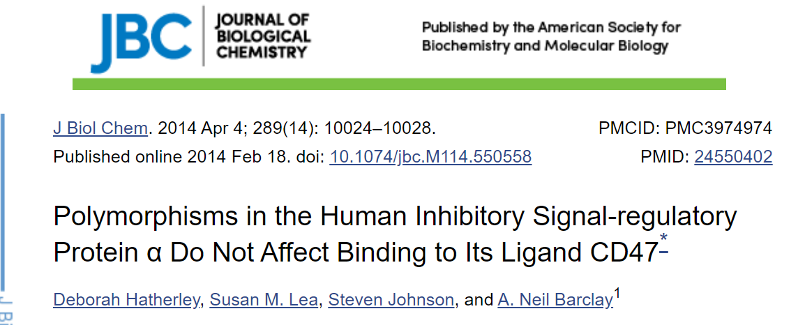
Signaling Assays for Most Common SIRPα Variants: V1 and V2
SIRPα Surface Expression
At least 10 SIRPα variants identified
SIRPα variants 1 and 2 (V1, V2) are most prevalent; differ by 15 amino acids
SIRPα V1
SIRPα V2
Comparable surface expression for SIRPα V1 and V2
SIRPα Functional Response
Similar assay window and IC₅₀ for SIRPα V1 and V2 with anti-CD47
* = *This work was supported by Medical Research Council Grants G9826026 and G0900888 and by Welcome Trust Senior Investigator Award 100298 (to the S. M. L. group).

Slide 22
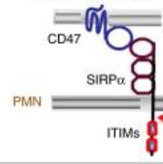
Mutation of SIRPα ITIM Motifs Disrupts CD47-Mediated Signaling
Evaluation of impact of mutations in the 4 tyrosine residues that are potential sites for phosphorylation: Y429, Y459, Y470 and Y496
Agonist
Antagonist
CD47
SIRPα
ITIMs
Y429, Y459
Y470, Y496
Adapted from Zen, K. et al. Nat Commun 2013; 4: 2436
Single mutations disrupted signaling to different degrees (data not shown), but mutation of 3 or more tyrosine residues completely abrogated CD47-mediated SHP recruitment

Slide 23
PathHunter® Checkpoint Receptors Assays
Industry’s Largest Menu of Stable Cell Lines and Bioassays
Functional Cell-based Assays
Tools for Testing Agonist Antibodies
Immunoglobulin Superfamily (IgSF)
TNFR Superfamily (TNFRSF)
Clustering Cell Lines
SIRPα
CD47
CD137
FcγRIa
FcγRIIa
FcγRIIb
ICOS
CD40
Early Access Cell Lines
CD28
OX40
CD200R
CD200
Binding Assays for Bi-specifics
CD27
PD-1/LAG3
PD-1/PD-L1
PD1 (SHP1)
PD-L1
PD-1/CTLA4
PD-L1/CTLA4
PD1 (SHP2)
PD-L2
PD-1/TIGIT
PD-L1/TIM3
BTLA
HVEM
PD-1/CEACAM1
TIM3/CEACAM1
CTLA4
CD86
PD-1/CD28
TIGIT/LAG3
mPD1
mPD-L1
mPD-1/mLAG3
mPD-1/mTIGIT
mCTLA4
mCD80
mPD-1/mCTLA4
Signaling Cell Lines
Ligand Cell Lines
Contact us for assays in-development, or custom solutions contact customdevelopment@eurofins.com

Slide 24
Thank You!
Options to suit your program needs
Cell Line Rental for in-house Testing
Proof-of-Concept Feasibility Study or Custom Assay Development
Purchase Cell Line or Bioassay Kits
Quick Confirmation with an eXpress Kit
Stable Cell Lines
Qualified Bioassays
MOA-based Bioassays
Analytical Cell Banks
Custom Assay Development
GPCRs
Checkpoint Receptors
Cytokine Receptors
Kinases
Signaling Pathways
TGFβ Superfamily
ADCC Assays
ADCP Assays
CDC Assays
Target Cells
Effector Cells
Contact us for assays in-development, or custom solutions contact customdevelopment@eurofins.com

Slide 25
Accelerating Immunotherapy Drug Development
Eurofins DiscoverX provides simple cell-based assays for immune checkpoint receptors to accelerate immunotherapy drug discovery and development
  No primary cells – Get biologically-relevant responses without primary cells
  Easy-to-use protocol with fast results – Increase efficiency with an “add-and-read” protocol and get results in 5-8 hours
  Highly sensitive response – Better sensitivity than competitor assays allows screening of early stage and dilute development samples
  Multiple applications – Drive development of biologic and small molecule drugs
  Support broader drug program – Cell-based assay for functional screening, lead optimization, and bioanalytical QC lot release applications
For further information: www.discoverx.com/checkpoint

